Slide 1
Executive summary templates
Use the Layout dropdown menu to select a template or build your own using these layouts as inspiration.

Slide 2
Title
Subtitle
Project Overview
Image Alt-Text Here

Slide 3
Title
Subtitle
Image Alt-Text Here
Image Alt-Text Here

Slide 4
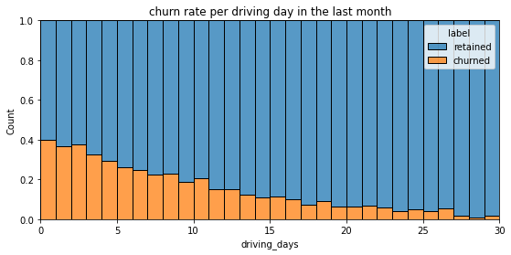
Addressing User Churn and Engagement: A Strategic Approach
Uncovering Root Causes and Developing Targeted Solutions for Improved User Retention and Engagement
The main issue identified is the high churn rate among users who didn't use the app much during the last month. There's also a high number of users who didn't drive at all during the month, which could indicate a lack of engagement or satisfaction with the app.
To address these issues, we need to understand the reasons behind these behaviors. We can do this by analyzing user data, conducting surveys, and observing user interactions with the app. Once we identify the root causes, we can develop targeted solutions to improve user retention and engagement.
There's a correlation between the number of days a user uses the app in a month and the number of kilometers they drive. Users who use the app more frequently tend to drive more. Also, there's a high churn rate among long-distance users, indicating that they might be dissatisfied with the app's features or services.
If these issues are not addressed, it could lead to a decrease in user base and revenue. By improving user retention and engagement, we can increase the lifetime value of our users, leading to higher revenue in the long term.

Slide 5
Title
Subtitle

Slide 6
Title
Subtitle
Image Alt-Text Here

Slide 7
Title
Subtitle

